Slide 1
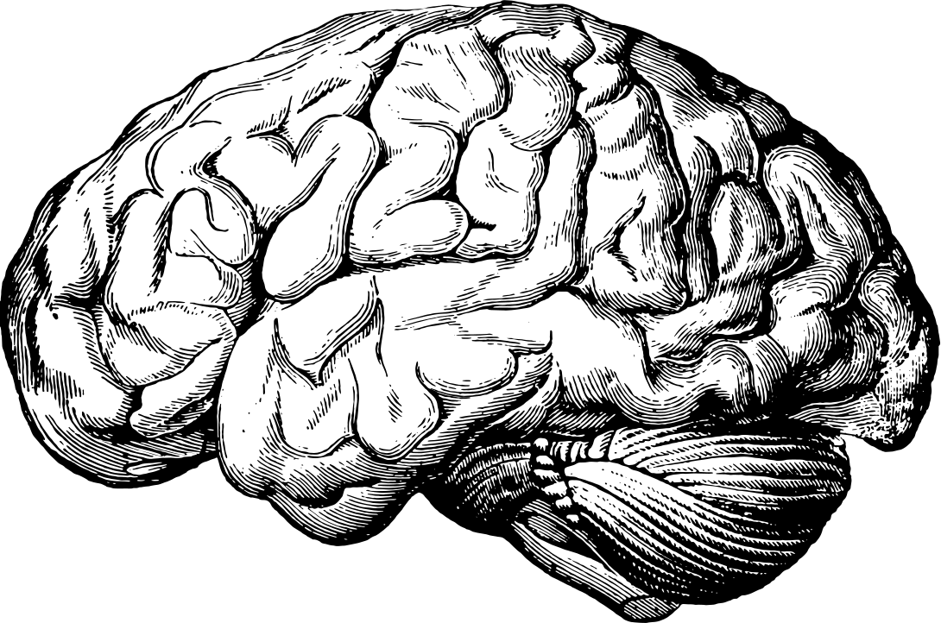
fMRIPrep: An Overview
Presented by
Margaret Gardner
Notes:
This presentation is a beginner/introductory overview of the fMRIPrep workflow, it's steps and what they do

Slide 2
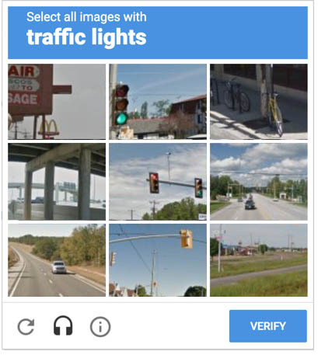
What is preprocessing?
Cleaning up our data to more easily identify meaningful signal.
PCMag
Notes:
Example - if we want to teach a computer to beat the recapta, we need to make each image more consistent (ie orientation, resolution, etc) so that the computer can find the signal (traffic light) in the noise.
Image from Definition of I Am Not a Robot | PCMag. (n.d.). PCMag. Retrieved October 19, 2021, from https://www.pcmag.com/encyclopedia/term/i-am-not-a-robot

Slide 3
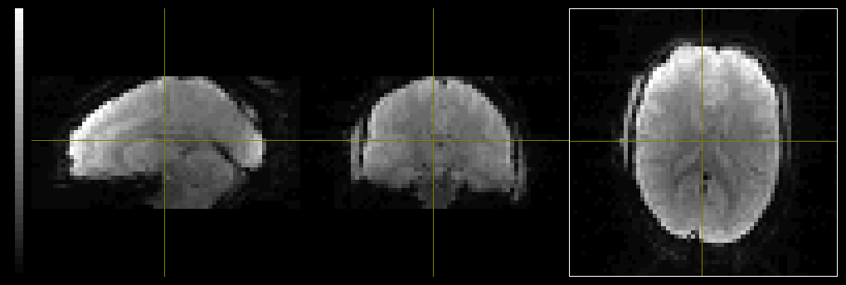
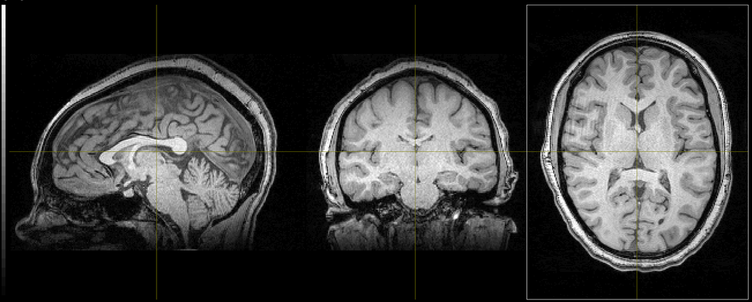
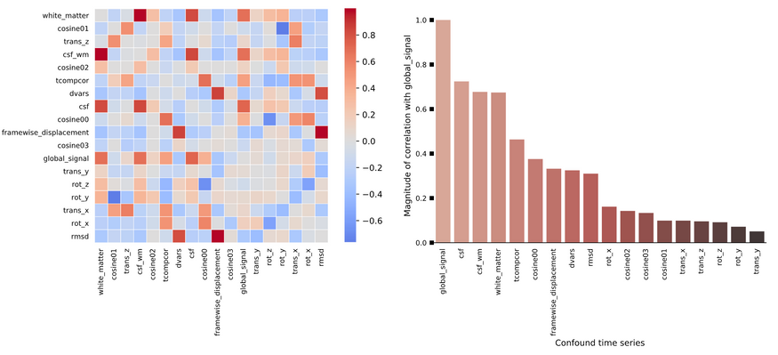
What is preprocessing?
Notes:
fmriprep inputs T1w and fMRI data (at minimum) and outputs "cleaned" single-subject data and confounds to use in higher-level analyses
Images from PennLINC nodra subject

Slide 4
Why fMRIPrep?
It's a BIDS App!
Can intelligently read info from BIDS inputs
Can automatically adapt processing based on the inputs available
Runs on Docker/Singularity, so it's all the subprograms (packages) are self-contained and reproducible
It uses NiPype!
Efficiently integrates processing scripts from several analyses packages with Python
It gives you lots of options for subsequent processing!
No spatial smoothing
Calculates many confounds
It's transparent!
Provides comprehensive visual QC reports automatically
Boilerplate citation for manuscripts
AFNI: environment for processing and displaying fMRI data
ANTs: set of tools to normalize data to standard spaces
FSL: popular set of tools for analyzing many types of MR data
FreeSurfer: program for analysis of (mostly) structural images, especially for surface analyses
tedana: Python library of tools for denoising multi-echo fMRI

Slide 5
Brain Extraction
Tissue Segmentation
Surface Preprocessing
Conform T1w Images
Bias Field Correction
Normalization
Refine Brain Mask
01
02
03
04
05
06
07
Normalization
07
01
02
03
04
06
08
Sample BOLD to Structural Surfaces
#
Co-Registration
Susceptibility Distortion Correction
05
09
Estimate Confounds
Estimate BOLD Reference
Estimate Head Motion
Slice-Time Correction
T2* echo combination
Pre-Processing in Native Space
Notes:
An overview of the fMRIPrep workflow

Slide 6
Brain Extraction
Tissue Segmentation
Surface Preprocessing
Conform T1w Images
Bias Field Correction
Normalization
Refine Brain Mask
01
02
03
04
05
06
07
Structural Workflow
Notes:
Structural preprocessing - not really the focus of fmriprep but will use for fmri

Slide 7
01
Conform T1w Images
Baseline
Follow-Up
Optional step to create a within-subject template for longitudinal studies in which you don't expect structural changes
Uses mri_robust_template from FreeSurfer
Can be helpful (i.e. more evenly distributing the transforms needed to normalize baseline and follow-up)
Unbiased (all images averaged) or aligned to first image
Average
Notes:
Conform T1w images
- Average longitudinal T1w’s into single ref template (assumes no substantial anatomical changes between sessions unless specified)
- Unbiased (all averaged) or aligned to 1st T1w (computationally easier if you have a lot of t1's)
- Now just use like a single t1w going forward
- Don’t do if you expect structural changes (degenerative disease population, kids, etc)

Slide 8
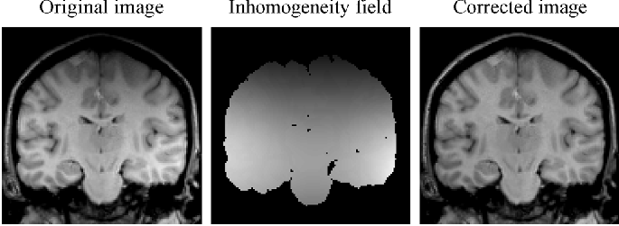
02
Bias Field Correction
Vovk U, Pernus F & Likar B, 2007
Identifies and corrects changes in voxel intensity caused by inhomogeneities in the magnetic field
Uses N4BiasFieldCorrection from ANTs
Notes:
Image from Vovk, U., Pernuš, F., Likar, B. (2007). A review of methods for correction of intensity inhomogeneity in MRI. IEEE Transactions on Medical Imaging, 26(3), 405–421. https://doi.org/10.1109/TMI.2006.891486

Slide 9
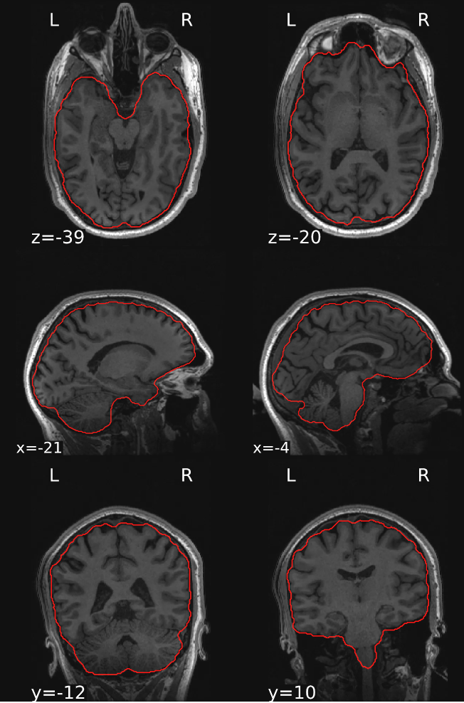
03
Brain Extraction
Removes all non-brain tissue
Uses antsBrainExtraction.sh from ANTs
Atlas-based - registers atlas whole-head image to T1w and applies atlas's brain mask to create subject's brain mask
Sometimes referred to as "skull-stripping"
fMRIPrep Sample Report
Notes:
Images from PennLINC nodra subject

Slide 10
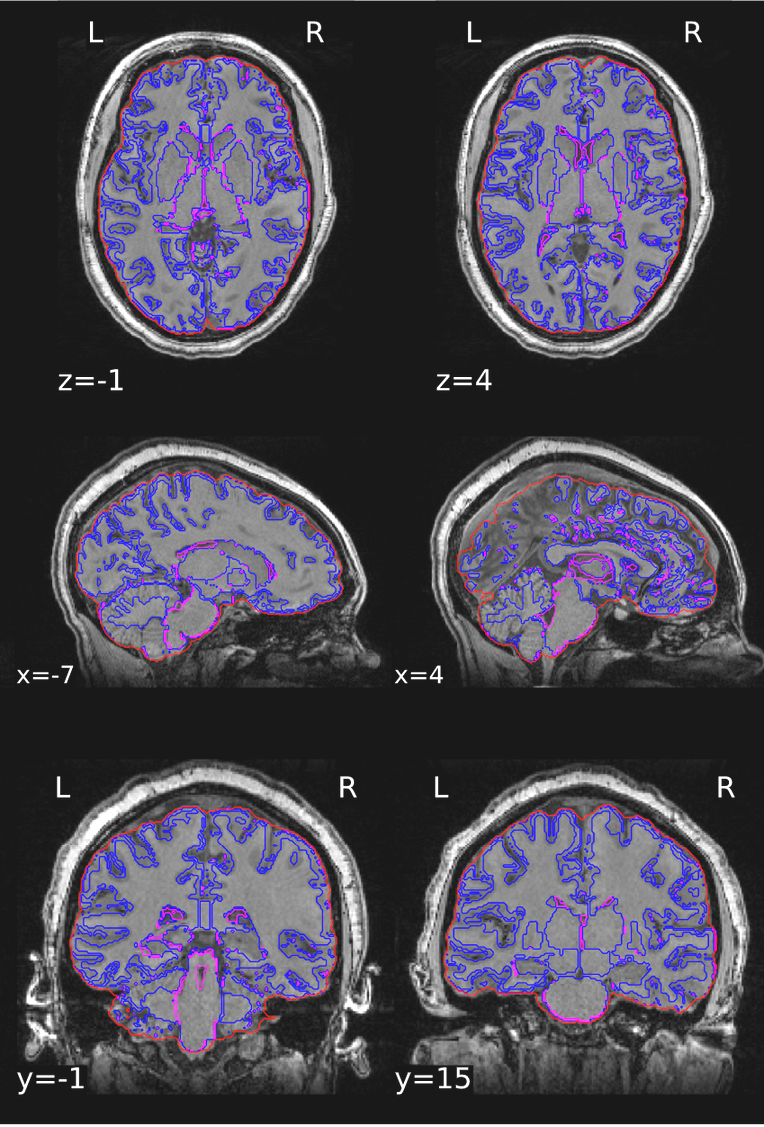
04
Tissue Segmentation
Divides image into tissue types (white matter, gray matter, CSF)
Uses fast from FSL
Model classifies tissue based on the voxel's intensity and the intensity of neighboring voxels
Reciprocally incorporates/assesses magnetic field inhomogeneity
Notes:
- hidden Markov random field model – uses voxel intensity but also probability of a voxel being X tissue based on it’s neighbor’s values
- corrects for RF field inhomogeneities (“bias field estimation and the segmentation are mutually influenced by each other” (Zhang, 2001))
Images from PennLINC nodra subject

Slide 11
05
Normalization
Fits subject's anatomical image to a standard template so you can compare between individuals
Uses antsRegistration from ANTs
Non-linear resampling
Can chose from standard or nonstandard templates ("spaces")
Keeps original resolution (unless specified)
Notes:
- i.e. make sure participant A’s somatosensory cortex will be in the same place as participant B’s so you can compare across
- Default to MNI152NLin2009cAsym, can chose from many templates
- Nonlinearly resample data to standard space (template) but keep original T1w resolution (unless other resolution specified)
- Nonstandard spaces: can resample to individual subjects’ anatomical ref based on T1w + T2w, individual’s FreeSurfer surfaces, in original grid, etc
Images from PennLINC nodra subject

Slide 12
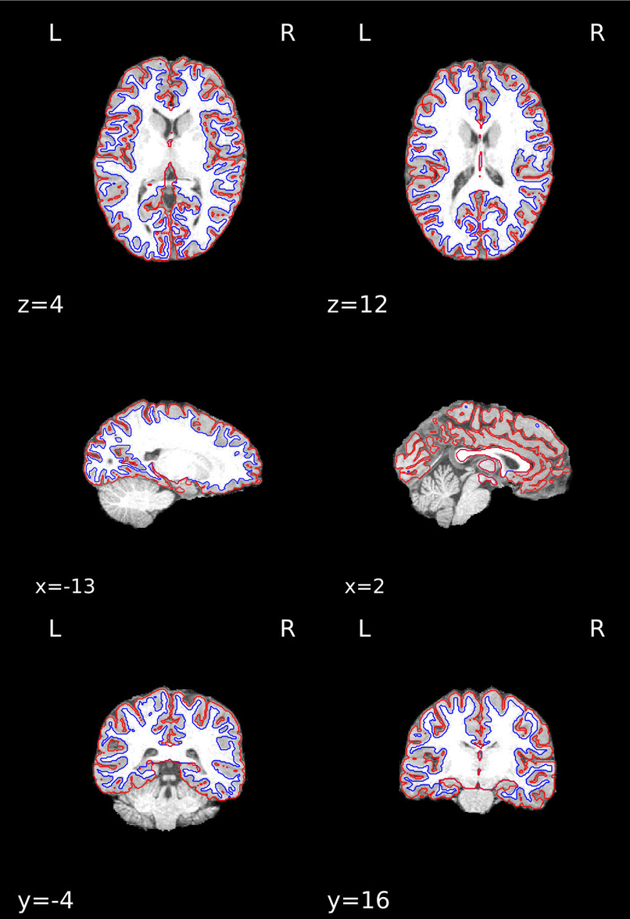
06
Surface Preprocessing
Optional assessment of boundary between white and gray matter (wm surface) and the cortical surface (pial surface)
Uses recon-all from FreeSurfer
Also calculates *.midthickness surfaces
Saves surfaces in GIFTI format
Uses T2w image if available
Notes:
reconall from FreeSurfer (using brain mask from step 2, not normalized)
- Reconstructs white and pial surfaces (use T2w and/or FLAIR when available)
- midthickness: surface halfway between WM surface and pial surface
- Surfaces also saved as GIFTI format (aligned to the FreeSurfer T1.mgz image, which may differ from the T1w space in some cases)
Images from PennLINC nodra subject

Slide 13
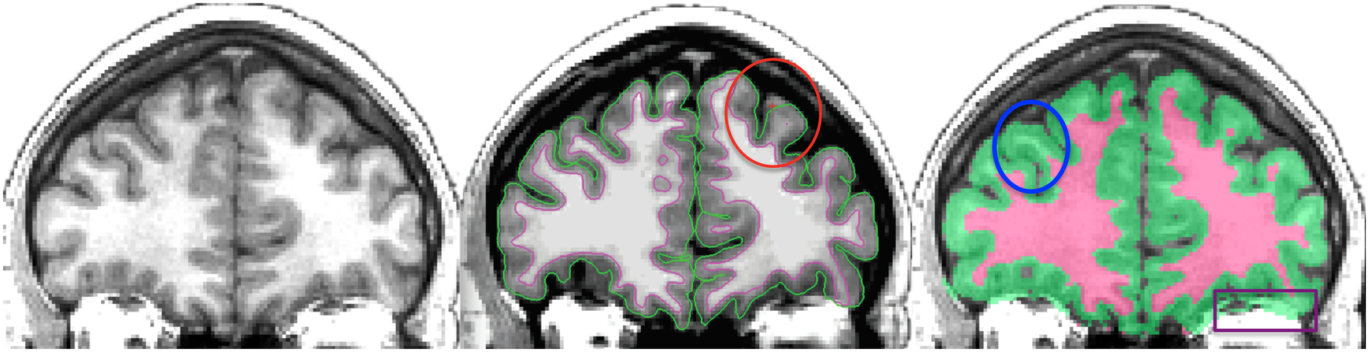
07
Refine Brain Mask
Cleans up the brain mask calculated by brain extraction based on the surface segmentation
Klein et al, 2017
Uses a custom adaptation of Mindboggle's hybrid segmentation algorithm
Unifies ANTs and FreeSurfer segmentations for the most accurate results
Notes:
Image from Klein, A., Ghosh, S. S., Bao, F. S., Giard, J., Häme, Y., Stavsky, E., Lee, N., Rossa, B., Reuter, M., Neto, E. C., & Keshavan, A. (2017). Mindboggling morphometry of human brains. PLOS Computational Biology, 13(2), e1005350. https://doi.org/10.1371/JOURNAL.PCBI.1005350

Slide 14
Surface Preprocessing
Refine Brain Mask
Normalization
05
06
07
Normalization
07
01
02
03
04
06
08
Sample BOLD to Structural Surfaces
10
Co-Registration
Susceptibility Distortion Correction
05
09
Estimate Confounds
Estimate BOLD Reference
Estimate Head Motion
Slice-Time Correction
T2* echo combination
Pre-Processing in Native Space
Functional Workflow

Slide 15
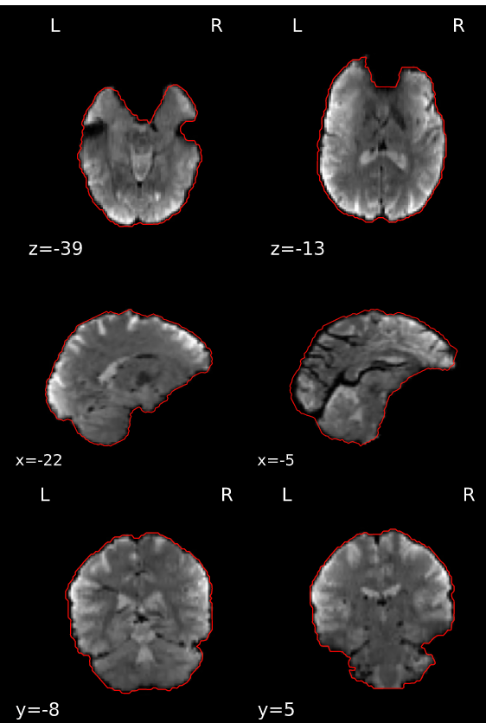
01
Estimate BOLD Reference
Creates a reference image from each functional run by averaging dummy scans or a motion-corrected subset of BOLD volumes
Also creates BOLD run brain mask
Uses sbref (single-band reference) if available
Used to assess head motion and co-registration
fMRIPrep Sample Report
Notes:
- Uses sbref if available, else averages “dummy scans” or motion corrected subset of BOLD volumes
-- single-band reference (sbref) - acquired before BOLD without slice acceleration (eg single-band, not multi-slice)
-- Dummy scans (aka consteady-states) - first few volumes of a run used to stabilize magnetic field, usually dropped but can be used for reference b/c they have better tissue contrast than actual BOLD scans
- Used in head motion estimation and registration to map BOLD onto T1w
Image from fMRIPrep Sample Report

Slide 16
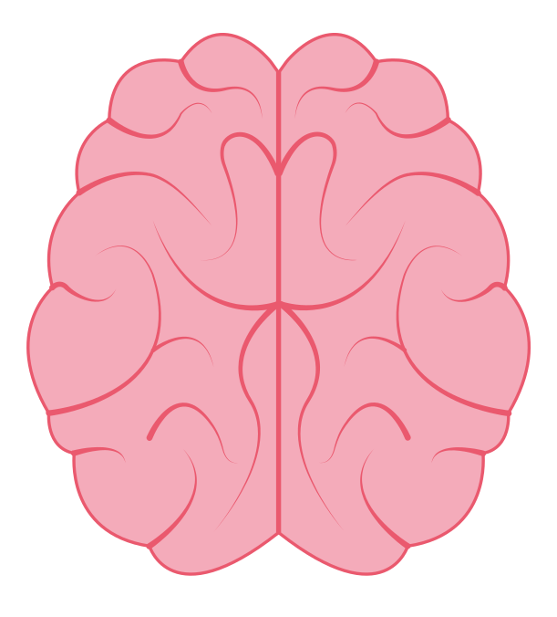
02
Estimate Head Motion
Writes a rigid-body transform - steps needed to bring brain back into alignment with the reference image - for each volume
Uses mcflirt from FSL
Calculated from 6 motion parameters (3 rotations & 3 translations) per time-step
Notes:
- Lists 6 parameters (directions, rotations, etc) per time-step (ref volume to each other volume) -> confounds
- Writes 1 rigid-body transform (movement steps needed to realign brain based on how it moved) for each BOLD time-step w/ respect to reference (middle volume typically)
-- Rigid body - brain is a “rigid” object, not smushing or expanding between volumes -> should be able to match back up based on realignment
-- use 1st step (ref to ref-adjacent) transform as a starting point to estimate 2nd step (ref to ref+2)
-- several steps (8mm, 4 mm, 4 mm strict) to get increasingly precise

Slide 17
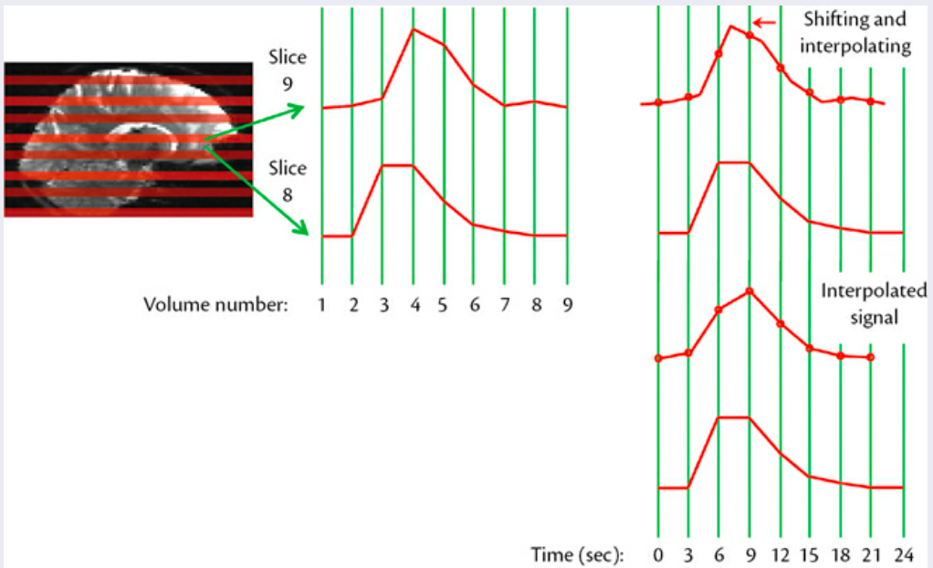
03
Slice Time Correction
Realigning 2D image slices to the middle TR (i.e. middle of that volume's acquisition)
Jenkinson & Chappell, 2018
Uses 3dTShift from AFNI
Can be skipped
Notes:
- Relies on SliceTiming in metadata, all slices realigned to middle of each TR
- Interpolation – using data we do have to model the data we don’t; scanner isn’t fast enough to get all the data at once, need to interpolate what slice X would have looked like at the time the middle slice was being measured
Image from Jenkinson, M., & Chappell, M. (Eds.). (2018). Introduction to Neuroimaging Analysis. Oxford University Press.

Slide 18
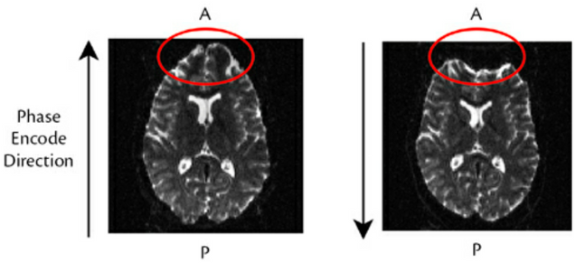
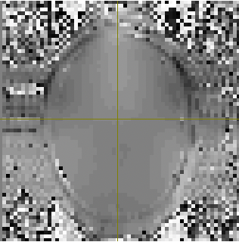
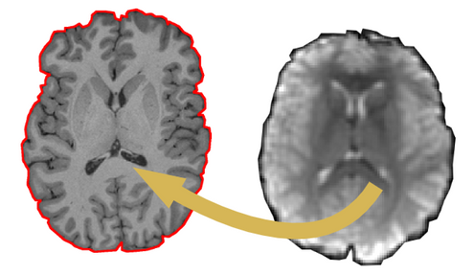
04
1
Susceptibility Distortion Correction
Jenkinson & Chappell, 2018
2
3
Correcting signal intensity noise caused by inhomogeneities in the magnetic field
Calculates the fieldmap by:
PE-Polar: Registering BOLD images acquired with opposite phase encoding directions to a reference and calculating voxel displacement
Direct: comparing echos in a double-echo sequence to reveal inhomogeneities
Fieldmap-less: Registering BOLD images to T1w to assess voxel displacement
Analogous to bias correction in structural workflow
Adapted from Esteban et al, 2019
Notes:
3 methods depending on data available, listed in order of preference
- phase encoding direction - direction of gradient that gradually/regularly misaligns the proton's phase - gives signal position; can cause regular distortion
- fieldmap-less - use T1w as unwarped reference to calculate against
Images from Jenkinson & Chappell, 2018; Esteban et al, 2019; PennLINC nodra subject

Slide 19
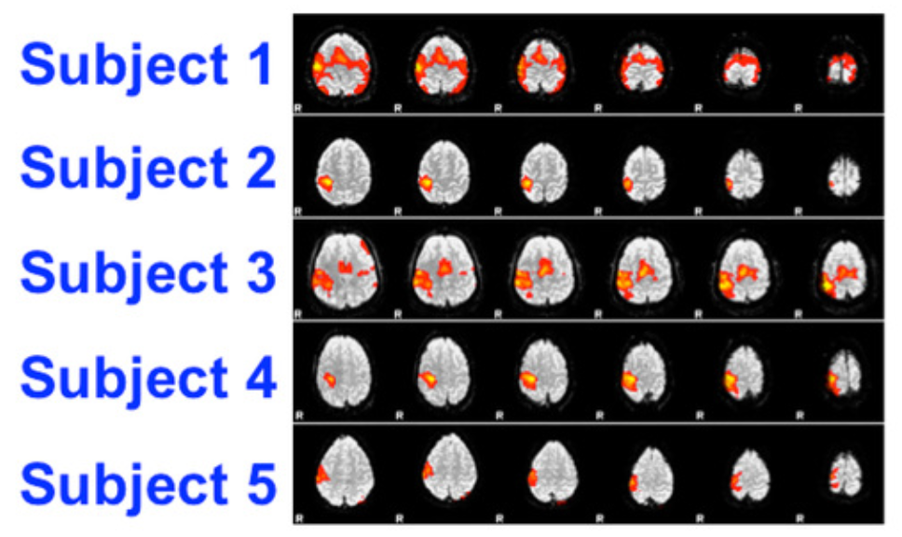
05
Pre-process BOLD in Native Space
Applying transforms calculated by motion correction, slice-timing correction, and signal distortion correction
Adapted from MRI Questions.com
Notes:
Image adapted from MRIQuestions.com (http://mriquestions.com/registrationnormalization.html)

Slide 20
06
Co-Registration
Aligns the BOLD reference image to the T1w brain mask by maximizing it's intensity gradient across the white-matter boundary
Uses bbregister from FreeSurfer or FLIRT from FSL
Notes:
- Based on freesurfer wm boundary
- “maximizing the gradient of the input image (BOLD) intensity across the surface boundary [of the T1w] ” (Greve & Fischl, 2009)
Image from PennLINC nodra subject

Slide 21
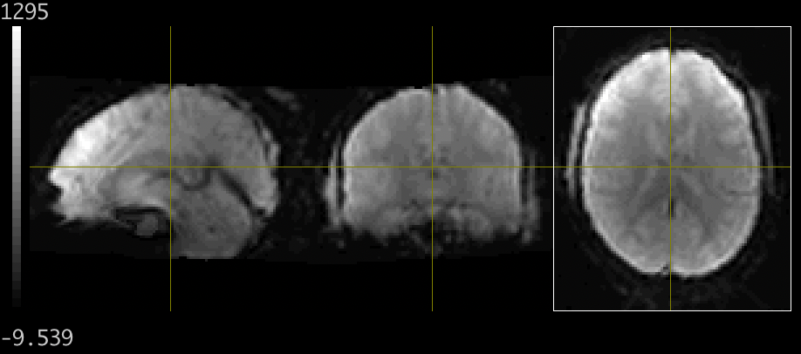
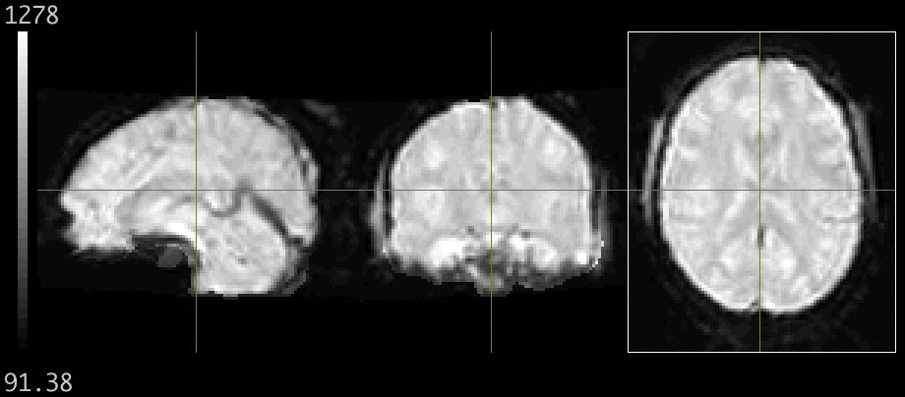
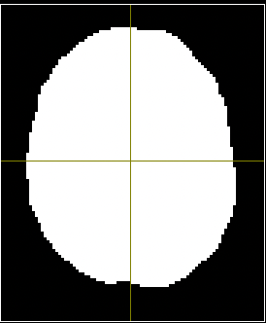
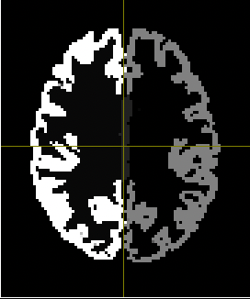
07
Normalization
1
Concatenates and applies all the transforms to map BOLD and T1w onto standard space
Simultaneously applies the transforms calculated by Head Motion Estimation, Susceptibility Distortion Correction, Co-Registration, and T1w Normalization
Outputs normalized:
fMRI (BOLD) series
BOLD reference
T1w brain mask
FreeSurfer surfaces
2
3
4
Notes:
can choose from many standard templates, custom standard templates or nonstandard spaces (individual T1w image, freesurfer surfaces...?)
Images from PennLINC nodra subject

Slide 22
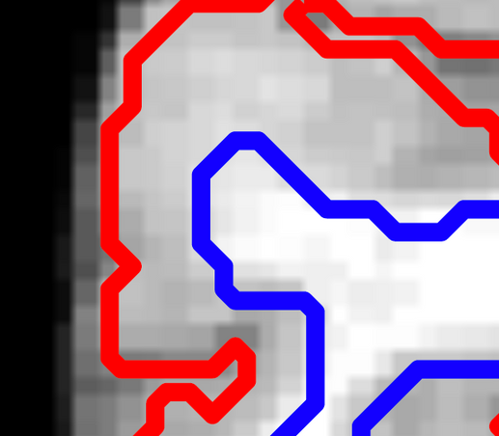
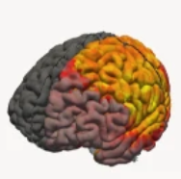
08
Sample BOLD to Structural Surfaces
BOLD timeseries is aligned to the cortical surfaces by averaging across the cortical ribbon
Uses mri_vol2surf from FreeSurfer
Calculated for native space and fsaverage (FreeSurfer's standard space)
Adapted from Esteban et al, 2019
Notes:
Average signal across cortical ribbon at each vertex (at right angle to WM boundary); sampled at 6 intervals then averaged
Images adapted from PennLINC nodra subject, adapted from Esteban et al 2019

Slide 23
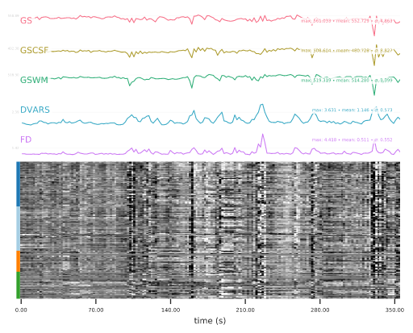
09
Tissue Segmentation
Refine Brain Mask
Co-Registration
05
07
Estimate Confounds
01
02
03
04
06
Estimate BOLD Reference
Estimate Head Motion
Slice-Time Correction
Susceptibility Distortion Correction
05
09
Estimate Confounds
Pre-Processing in Native Space
Identifies many sources of potential noise in the signal that you can choose if/how to resolve:
Mean signals (global and for each tissue type)
Frame-wise Displacement
6 motion parameters
Spike regressors
Temporal and Anatomical CompCore
DVARS
ICA-AROMA
Notes:
- mean global signal
- mean tissue class signal
- Frame-wise Displacement - quantitative rating of head motion (sum of 6 motion parameters)
- 6 motion parameters
- spike regressors - timepoints identified as motion artifacts/marked for regression
- aCompCore - calculate principal components from ROIs that shouldn’t have signal (CSF, WM masks), can regress out in denoising
- tCompCor - ROI is a mask of voxels with the highest temporal standard deviation (voxels w/ high level of physiological noise)
- DVARS - rate of change of BOLD across entire brain at each vol (how much intensity of a brain image changes in comparison to previous timepoint)
-- Different from global signal (average val of intensity at a timepoints)
-- Frame-to-frame changes shouldn’t be big based on actual signal - big change from one timepoint to another means its probably movement
Image from PennLINC nodra subject

Slide 24
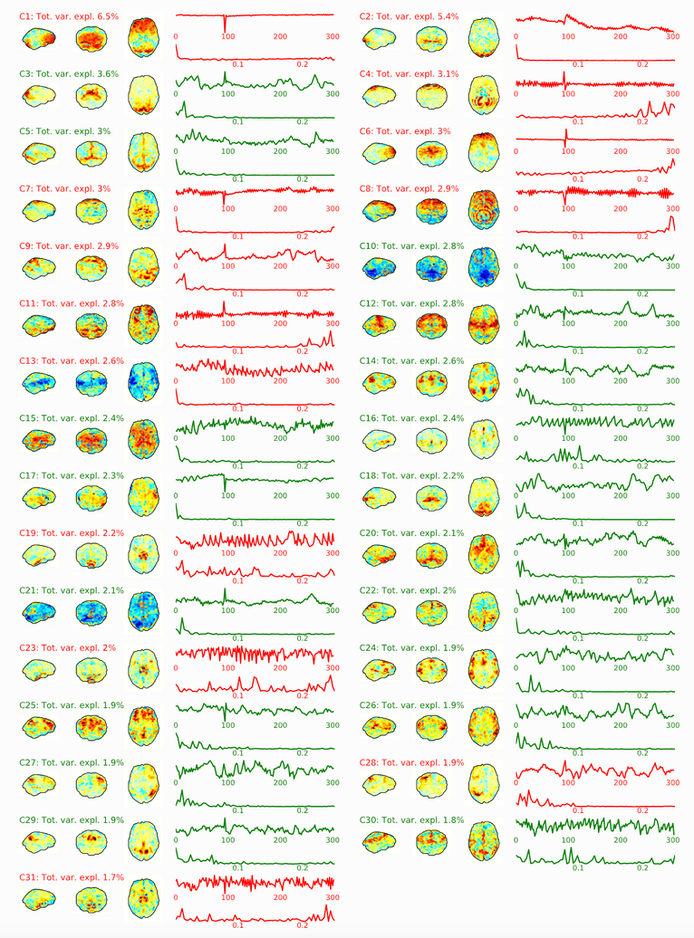
09
ICA-AROMA
Sub-workflow of Confound Regression that uses independent component analysis (ICA) to identify and remove signal caused by head motion
Applies non-aggressive denoising to normalized BOLD data
Calculated for both native space and normalized BOLD data
Provides confounds to run aggressive denoising if desired
fMRIPrep Sample Report
Notes:
identifies time series of head motion confounds
- Calculated in both native (t1w) space and MNI normalized data
- IC defined as noise based on correlation with head motion parameters (assessed by mcflirt above), how much signal comes from the edges of the brain (which will be shifted by motion), how much is from CSF, and if there’s a lot of high-frequency signal
- Automatically applies non-aggressive denoising
-- Aggressive – totally cut out all independent signal components that are identified as noise; can over-edit b/c you also remove any variance that’s shared with good/non-noise components
-- Non-aggressive – cut out only the variance that’s exclusive to noise ICs
Image from fMRIPrep Sample Report

Slide 25
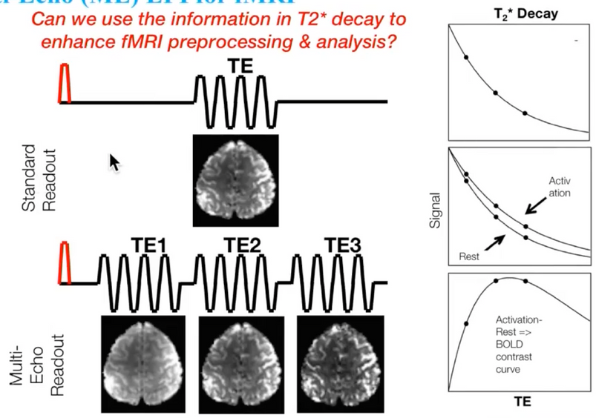
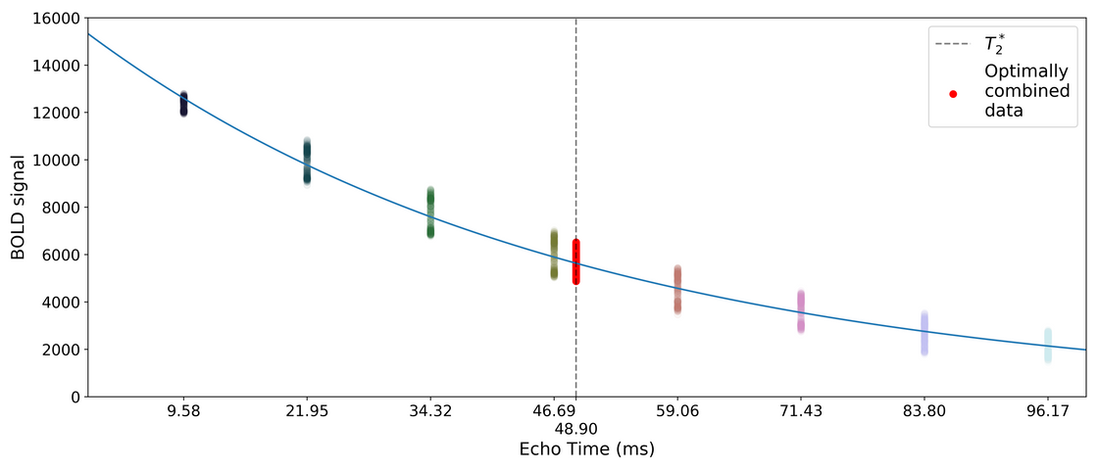
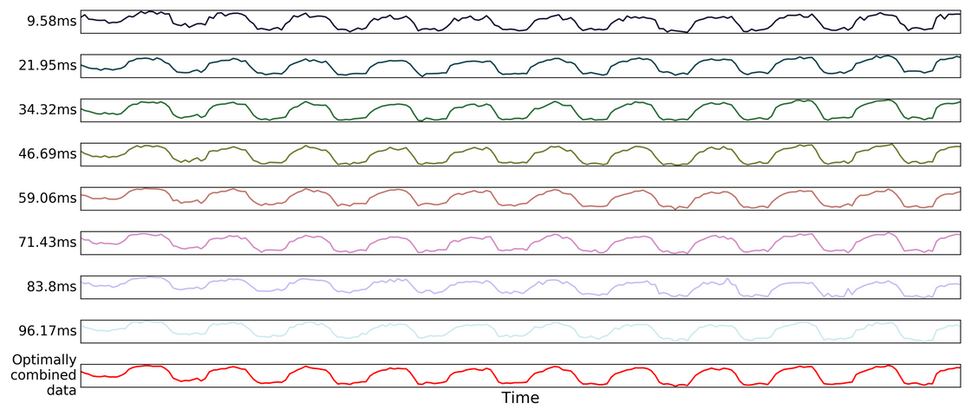
#
T2*-driven Echo Combination
Adapted from Kundu, P, 2017
Uses multi-echo data to create a T2* map then optimally combines echos into a single BOLD time series
tedana developers, Revision 4d5c6456
Integration of part of tedana
Estimates T2* for each voxel to create a map
Uses a weighted average to compute BOLD at each voxel's optimum TE
Notes:
- For multi-echo imaging – acquire multiple volumes per RF pulse so you’re at different echo times (time between RF pulse and acquisition)
- T2* - observed decay in signal/relaxation rate (incorporates tissue properties AND magnetic distortions cause by blood oxygenation – aka BOLD)
- Each voxel will have an optimal echo time based on tissue type and hemodynamic response (ie brain activation), etc – by sampling a lot you’re more likely to catch it
-- Early echos have higher signal, later echos have higher sensitivity to BOLD
-- Optimal combination – for each voxel, combine data (weighted average) across all the TE’s you captured to interpolate what the data would be at that voxel’s optimal TE
Images adapted from Kundu, P. (n.d.). How-to use multi-echo data for de-noising | OHBM. Retrieved October 18, 2021, from https://www.pathlms.com/ohbm/courses/5158/sections/7788/video_presentations/75977
tedana’s denoising approach — tedana 0.0.11rc1+9.g4d5c645.dirty documentation. (n.d.). Retrieved October 18, 2021, from https://tedana.readthedocs.io/en/latest/approach.html#optimal-combination

Slide 26
References
Acquiring and using field maps — LCNI. (n.d.). Retrieved October 18, 2021, from https://lcni.uoregon.edu/kb-articles/kb-0003
Behzadi, Y., Restom, K., Liau, J., & Liu, T. T. (2007). A component based noise correction method (CompCor) for BOLD and perfusion based fMRI. NeuroImage, 37(1), 90–101. https://doi.org/10.1016/J.NEUROIMAGE.2007.04.042
Esteban, O., Markiewicz, C. J., Blair, R. W., Moodie, C. A., Ilkay Isik, A., Erramuzpe, A., Kent, J. D., Goncalves, M., DuPre, E., Snyder, M., Oya, H., Ghosh, S. S., Wright, J., Durnez, J., Poldrack, R. A., &
Gorgolewski, K. J. (n.d.). fMRIPrep: a robust preprocessing pipeline for functional MRI. https://doi.org/10.1038/s41592-018-0235-4
Greve, D. N., & Fischl, B. (2009). Accurate and Robust Brain Image Alignment using Boundary-based Registration. NeuroImage, 48(1), 63. https://doi.org/10.1016/J.NEUROIMAGE.2009.06.060
Jenkinson, M., & Chappell, M. (Eds.). (2018). Introduction to Neuroimaging Analysis. Oxford University Press.
Jenkinson, M., Bannister, P., Brady, M., & Smith, S. (2002). Improved Optimization for the Robust and Accurate Linear Registration and Motion Correction of Brain Images. NeuroImage, 17(2), 825–841. https://doi.org/10.1006/NIMG.2002.1132
Klein, A., Ghosh, S. S., Bao, F. S., Giard, J., Häme, Y., Stavsky, E., Lee, N., Rossa, B., Reuter, M., Neto, E. C., & Keshavan, A. (2017). Mindboggling morphometry of human brains. PLOS Computational Biology, 13(2), e1005350. https://doi.org/10.1371/JOURNAL.PCBI.1005350
Kundu, P. (n.d.). How-to use multi-echo data for de-noising | OHBM. Retrieved October 18, 2021, from https://www.pathlms.com/ohbm/courses/5158/sections/7788/video_presentations/75977
Magnetism - Questions and Answers ​in MRI. (n.d.). Retrieved October 19, 2021, from http://mriquestions.com/registrationnormalization.html
Power, J. D., Barnes, K. A., Snyder, A. Z., Schlaggar, B. L., & Petersen, S. E. (2012). Spurious but systematic correlations in functional connectivity MRI networks arise from subject motion. NeuroImage, 59(3), 2142–2154. https://doi.org/10.1016/J.NEUROIMAGE.2011.10.018
Processing pipeline details — fmriprep version documentation. (n.d.). Retrieved October 19, 2021, from https://fmriprep.org/en/stable/workflows.html#
Recapta image. Definition of I Am Not a Robot | PCMag. (n.d.). PCMag. Retrieved October 19, 2021, from https://www.pcmag.com/encyclopedia/term/i-am-not-a-robot
RHR, P., M, M., D, van R., A, L., JK, B., & CF, B. (2015). ICA-AROMA: A robust ICA-based strategy for removing motion artifacts from fMRI data. NeuroImage, 112, 267–277. https://doi.org/10.1016/J.NEUROIMAGE.2015.02.064
Satterthwaite, T. D., Elliott, M. A., Gerraty, R. T., Ruparel, K., Loughead, J., Calkins, M. E., Eickhoff, S. B., Hakonarson, H., Gur, R. C., Gur, R. E., & Wolf, D. H. (2013). An improved framework for confound regression and filtering for control of motion artifact in the preprocessing of resting-state functional connectivity data. NeuroImage, 64(1), 240–256. https://doi.org/10.1016/J.NEUROIMAGE.2012.08.052
tedana’s denoising approach — tedana 0.0.11rc1+9.g4d5c645.dirty documentation. (n.d.). Retrieved October 18, 2021, from https://tedana.readthedocs.io/en/latest/approach.html#optimal-combination
The fMRIPrep Developers. (n.d.). fMRIPrep Sample Report. Retrieved October 19, 2021, from https://fmriprep.org/en/stable/_static/sample_report.html
Vovk, U., Pernuš, F., & Likar, B. (2007). A review of methods for correction of intensity inhomogeneity in MRI. IEEE Transactions on Medical Imaging, 26(3), 405–421. https://doi.org/10.1109/TMI.2006.891486
Zhang, Y., Brady, M., & Smith, S. (2001). Segmentation of brain MR images through a hidden Markov random field model and the expectation-maximization algorithm. IEEE Transactions on Medical Imaging, 20(1), 45–57. https://doi.org/10.1109/42.906424
Notes:
Oxford Primer
fmriprep website
website for traffic light photo
fmriprep nature paper
ICA-AROMA paper
Greve & Fischl, 2009
vovk bias field correction
power 2012
tedana site
kundu video
compcor paper
mriquestions.com
zhang 2001
fmriprep sample report
jenkinson 2001
Esteban et al, 2019
satterthwaite 2012

Slide 27
Additional
Resources
Conforming T1w Images
Reuter M, Schmansky NJ, Rosas HD, Fischl B. Within-subject template estimation for unbiased longitudinal image analysis. Neuroimage. 2012;61(4):1402-1418. doi:10.1016/j.neuroimage.2012.02.084
Bias Field Correction
Tustison NJ, Avants BB, Cook PA, et al. N4ITK: improved N3 bias correction. IEEE Trans Med Imaging.
2010;29(6):1310-1320. doi:10.1109/TMI.2010.2046908
Estimating BOLD Reference
Facey, G. (2010, April 7). University of Ottawa NMR Facility Blog: Dummy Scans. http://u-of-o-nmr-facility.blogspot.com/2010/04/dummy-scans.html
T2* Echo Combination & Multi-Echo Sequences
Kundu P, Voon V, Balchandani P, Lombardo MV, Poser BA, Bandettini PA. Multi-echo fMRI: A review of applications in fMRI denoising and analysis of BOLD signals. Neuroimage. 2017;154:59-80. doi:10.1016/j.neuroimage.2017.03.033

Slide 28
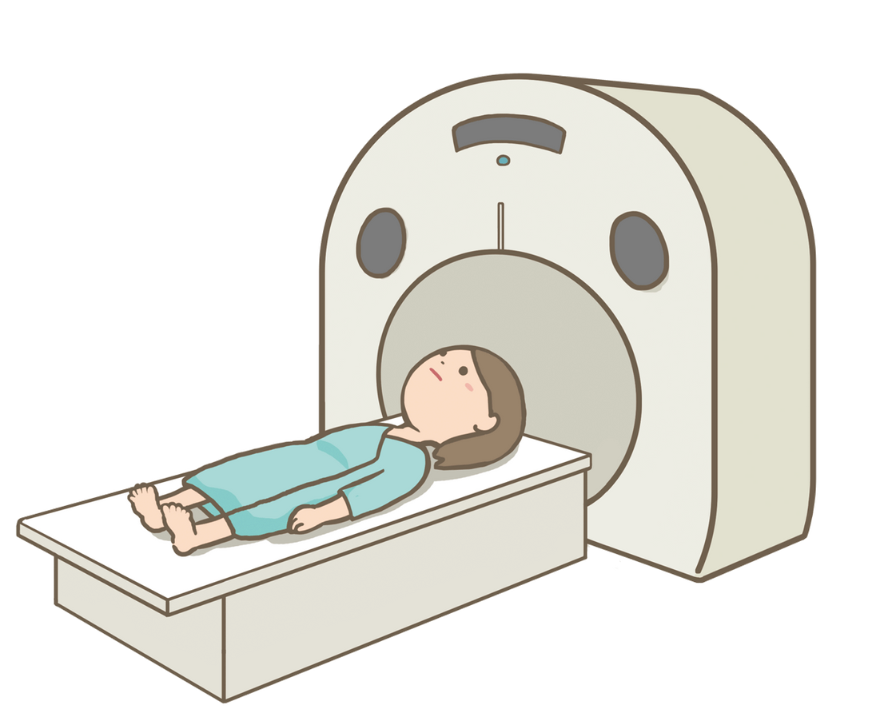
Thanks!

